Slide 1
Learn something about Open cluster
邱钰 Yu Qiu
庞宇萱 YuXuan Pang
潘志伟 Zhiwei Pan
12/20/19

Slide 2
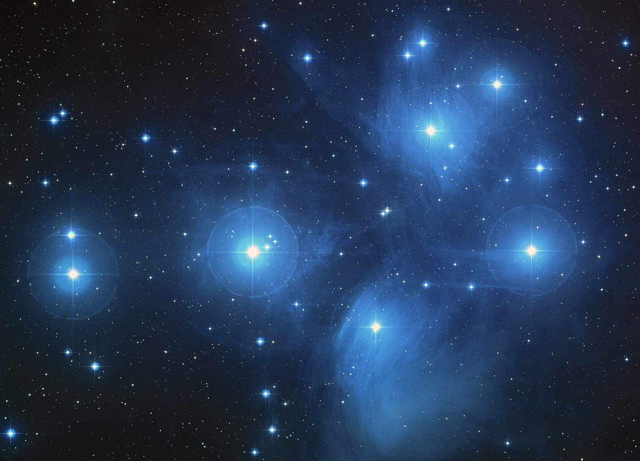
Introduction: open cluster (OC)
What is OC ?
Disk
Young: million years old to billion
Same age & metallicty
& same gas cloud
Image Credit: NASA

Slide 3
Why do we study OC ?
Image credit: University of Cambridge
Image Credit: NASA
Milky Way structure
Evolution of Galactic disk
Open cluster evolution

Slide 4
How do we study OC ?
Evolution-> statastics-> OC sample
OC membership selection
Sample Anaysis->parameters
Mass and age determination
Parameters
Evolution

Slide 5
Open cluster membership selection
Zhiwei Pan 潘志伟

Slide 6
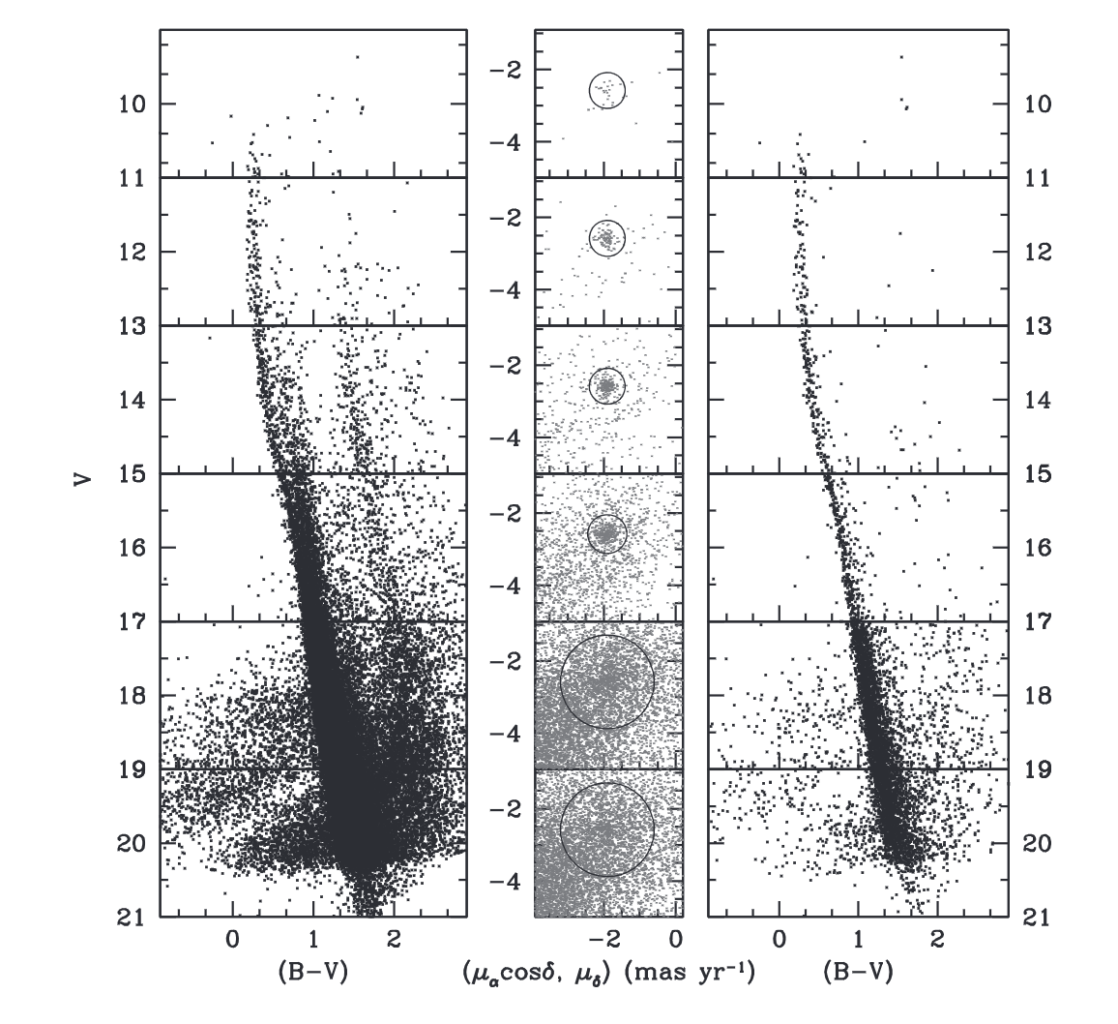
Previous study: a difficult problem
Proper motion vector point diagram
(VPD)
Color magnitude diagram (CMD)
parallax
Arbitrary and uncommon !
Rangwal et al. 2019

Slide 7
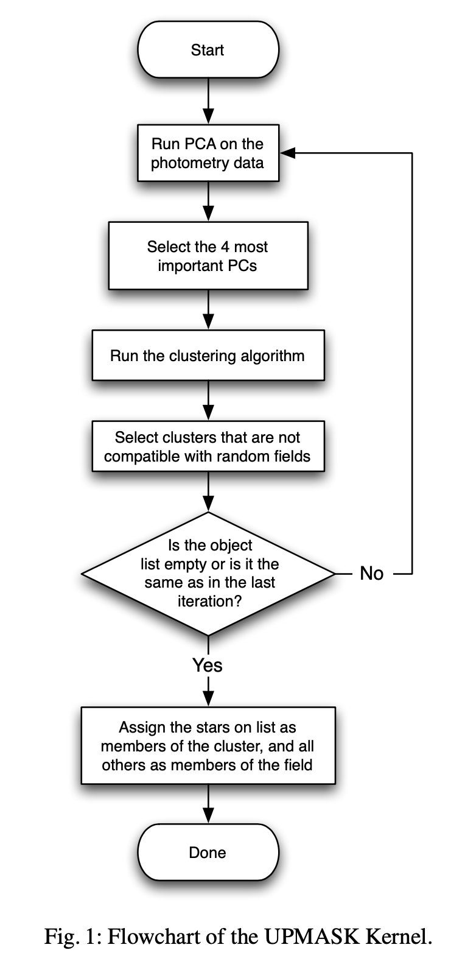
A general method
——They who know nothing fear nothing（不知者无畏）
Code/pipeline： k-mean clustering , principle components analysis
Limited time
Maybe incorrect
in some cases
Cantat-Gaudin et al. 2018

Slide 8
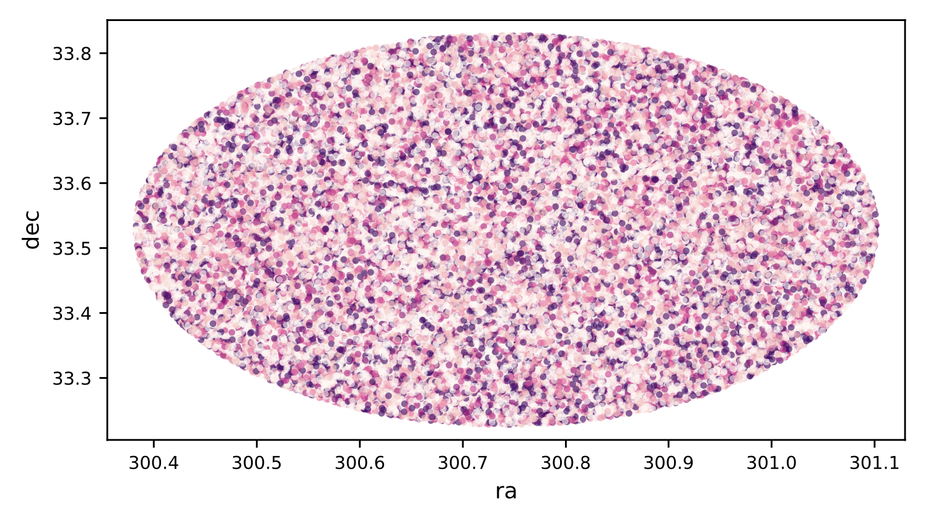
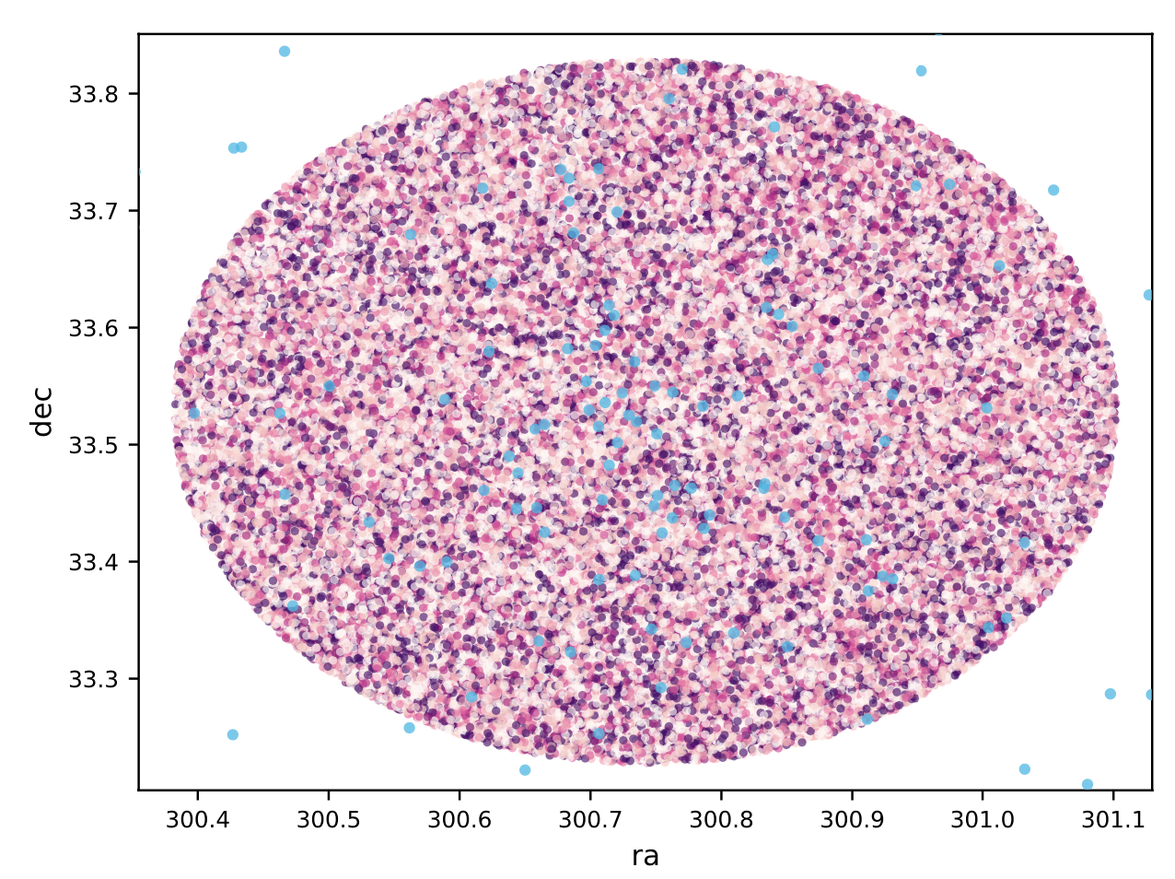
ASCC 110

Slide 9
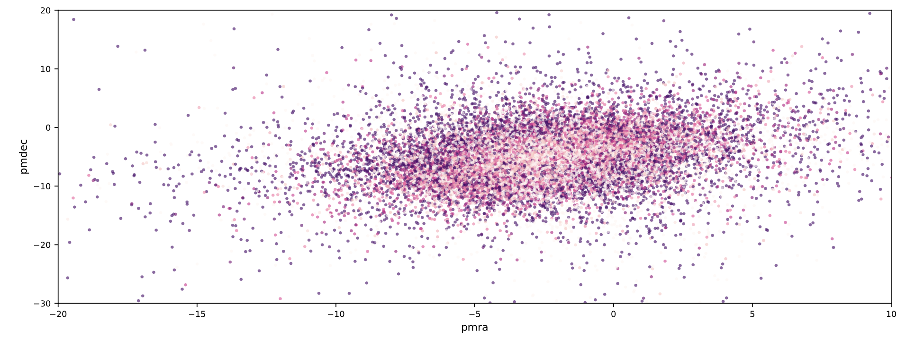
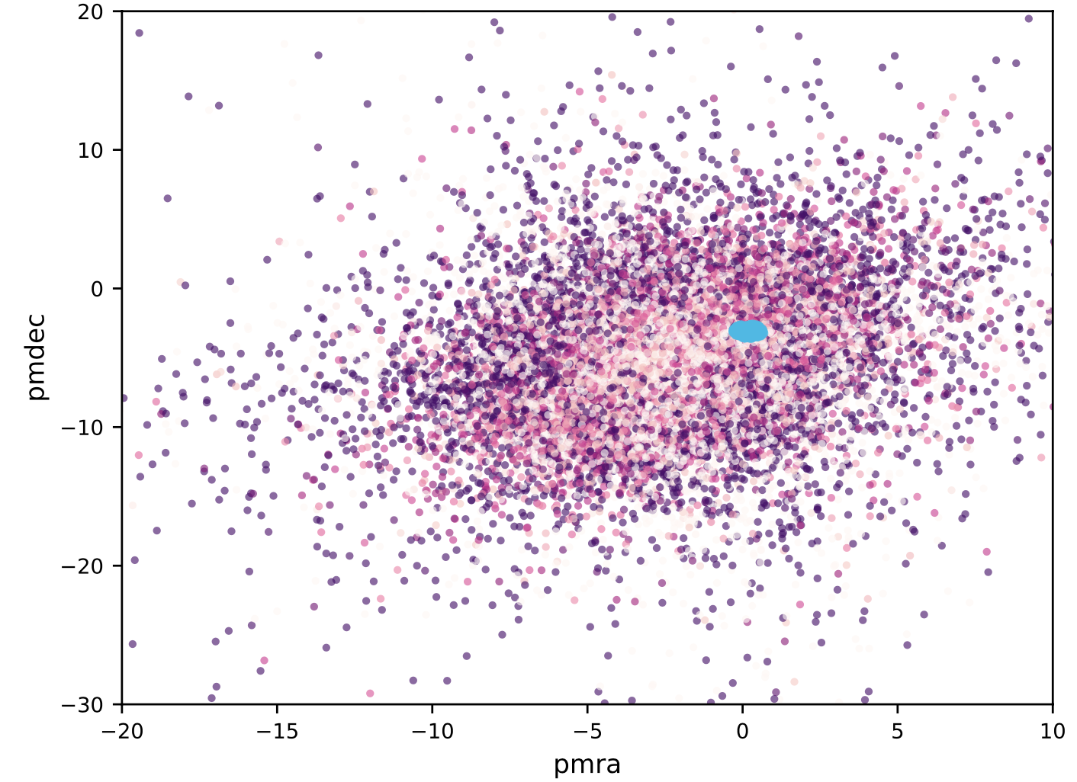

Slide 10
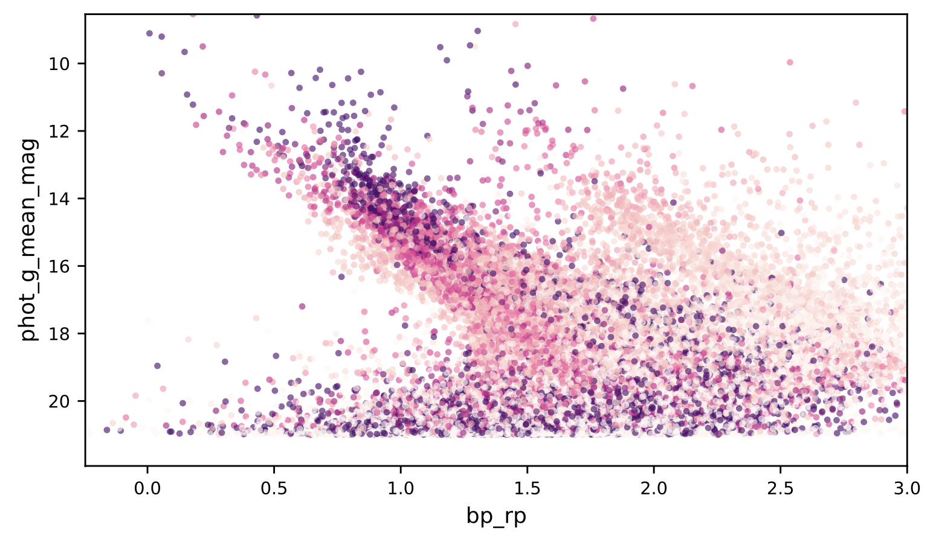
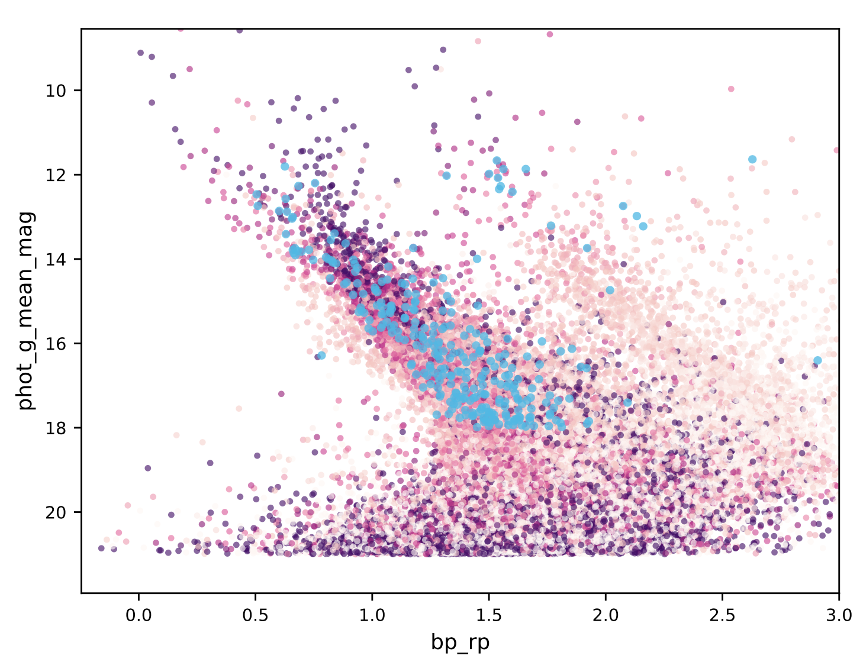

Slide 11
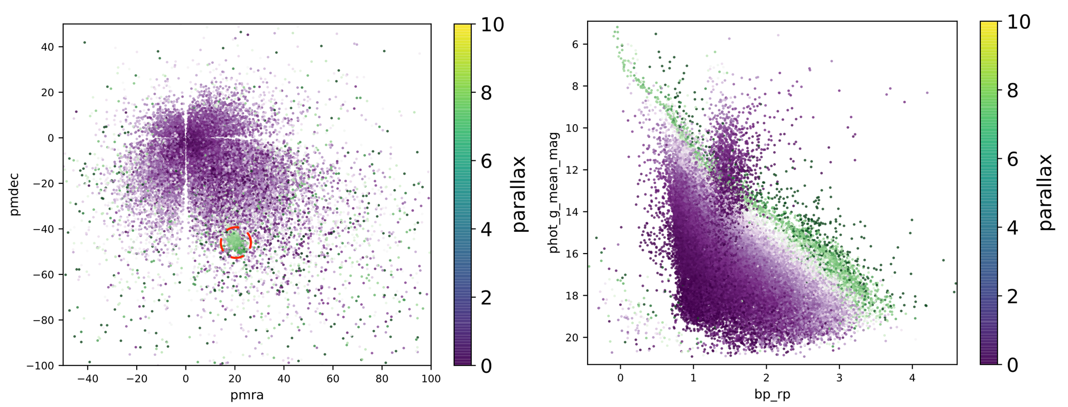
Come back to the beginning:
——how to select an individual OC?
——What are the good characteristics for OC visual identification?
Melotte 22

Slide 12
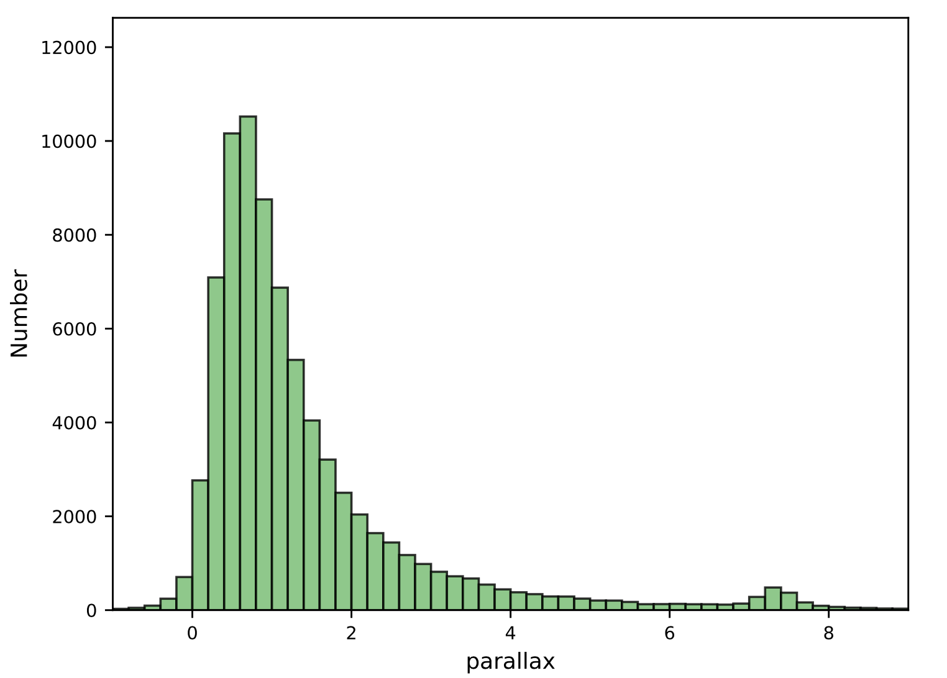
Good characteristics:
large parallax
Small error
different central location
of parallax distribution

Slide 13
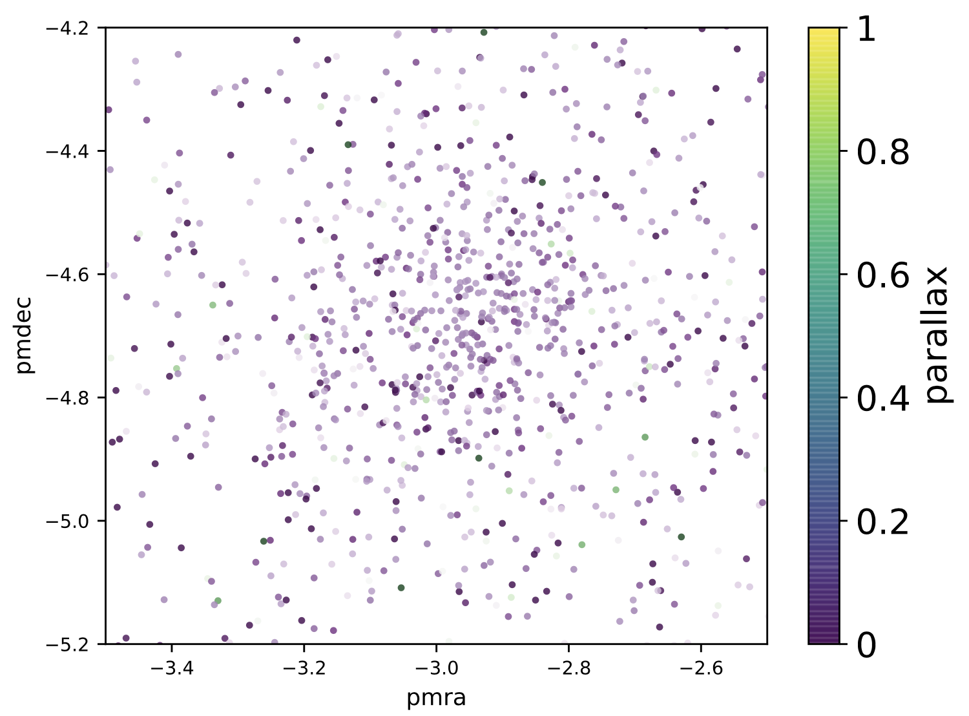
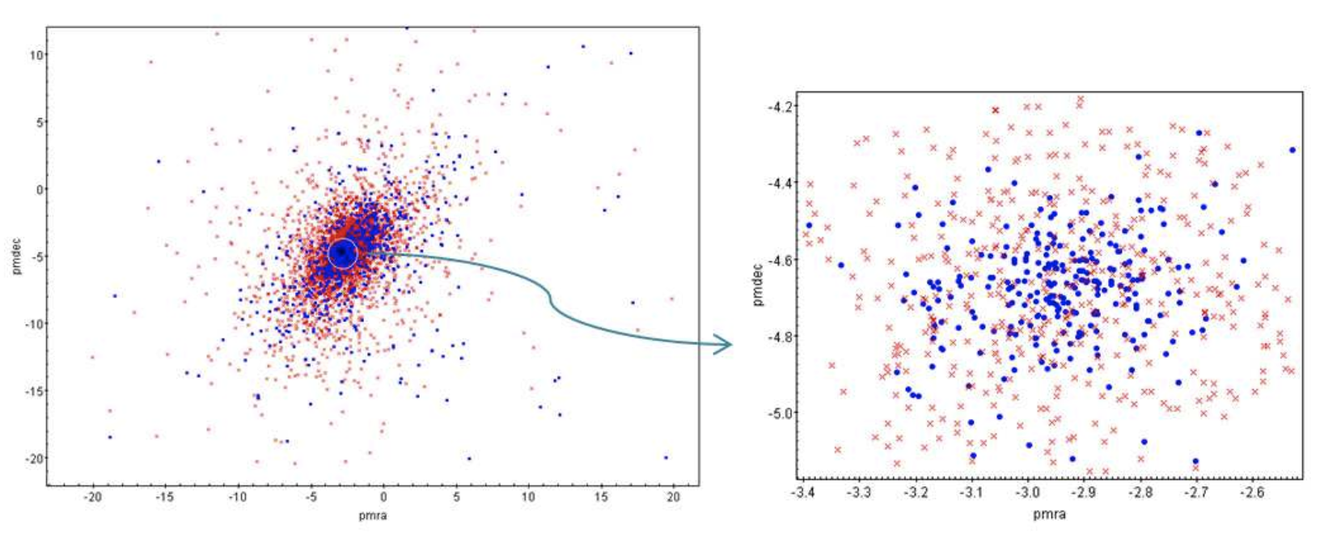
Tadross 2018: Dolidze 41
Bad characteristics:
similar proper motion distribution
With field stars (background noise)

Slide 14
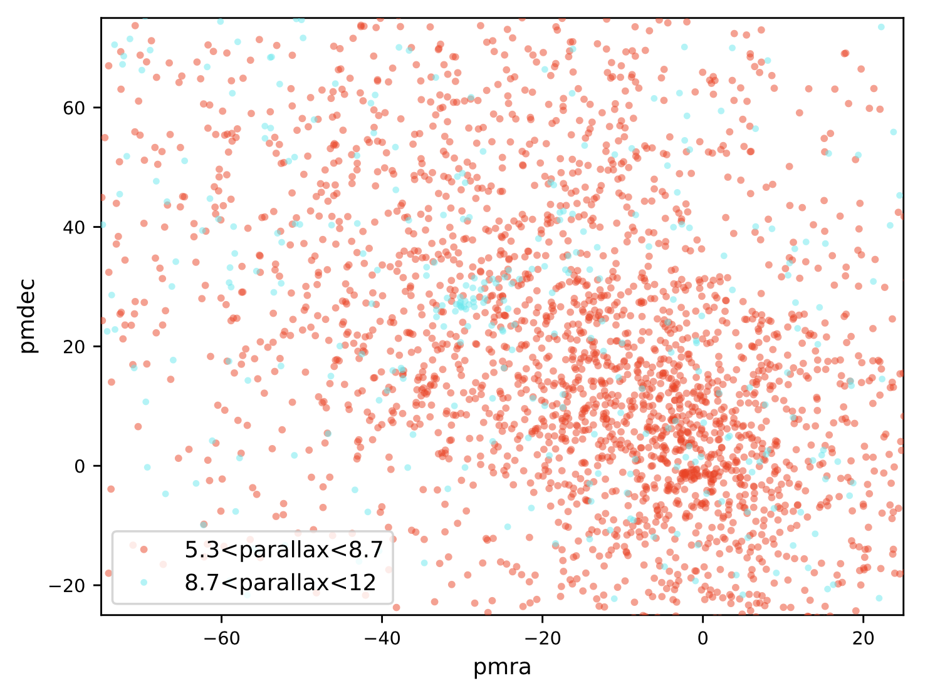
More is better!
Mamajek 1

Slide 15
Brief Summary
Fail to write a pipeline for OC selection
Good characteristics: large parallax, different distribution from background, many members
Provide some insight on future selection:
More precise observation than Gaia
Add radial velocity
Be careful about the pipeline result in some cases.

Slide 16
Mass and Age Determination
CMD Fitting
Yuxuan Pang 庞宇萱

Slide 18
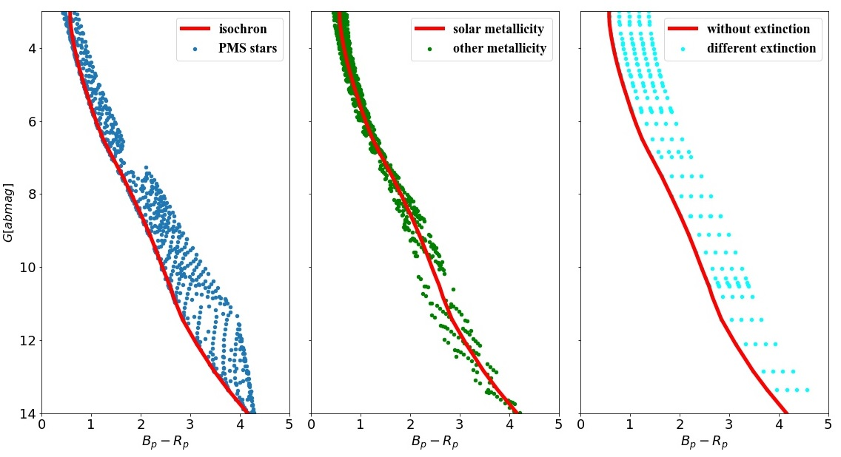
The limitation of CMD fitting

Slide 19
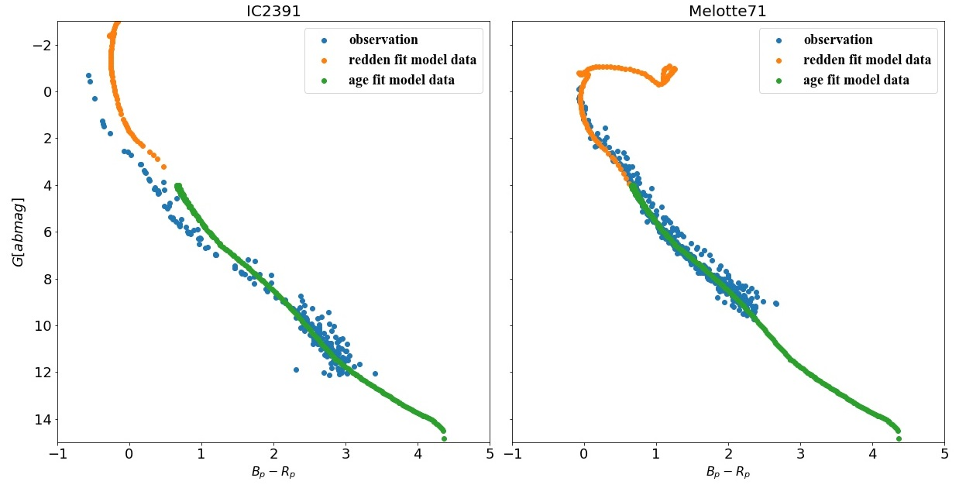
Linear redden model

Slide 20
Data Lists
Gaia data
Gaudin 2018
Bossini 2019
Bailer-Jones 2018
Extinction
Members of 1229 OCs
269 OCs, nearly half have metallicity
Distance of Gaia stars

Slide 21
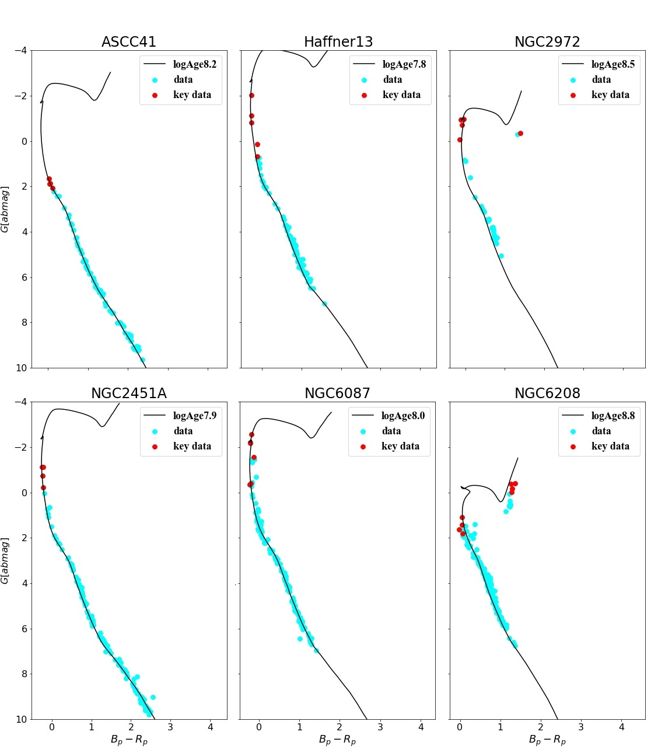
Final Fitting Result
Key data
Red Giant branch

Slide 22
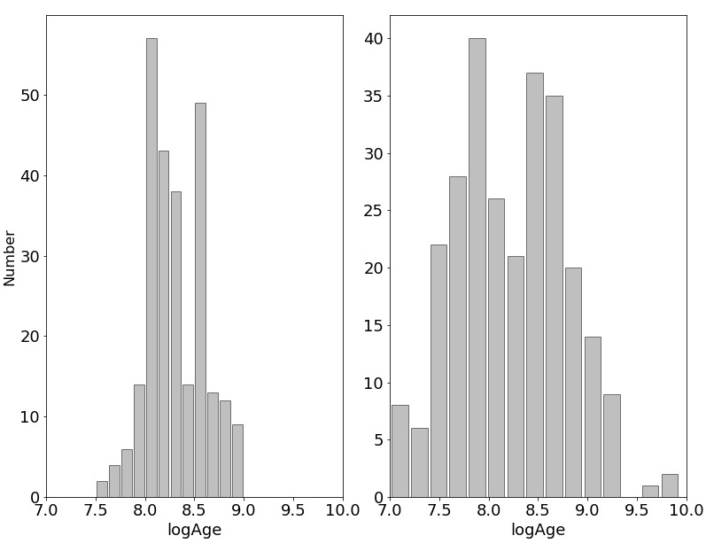
Age Distribution of 200+ OCs

Slide 23
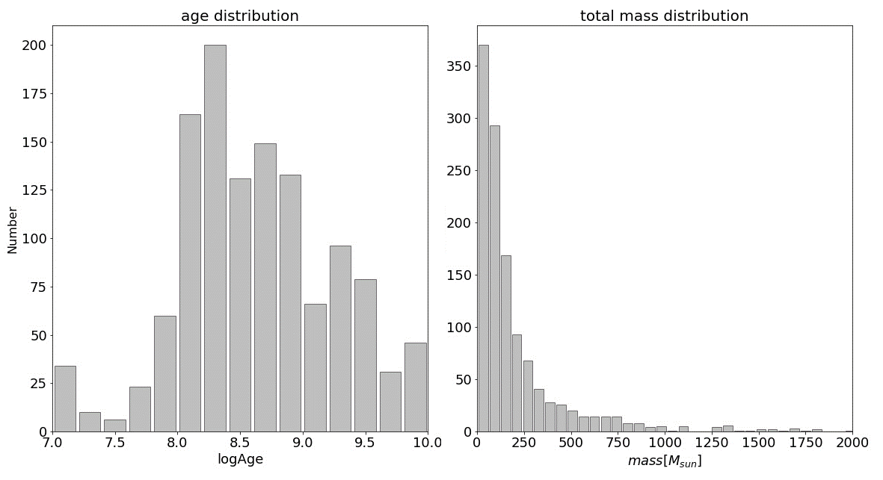
Final Age and Mass Distribution

Slide 24
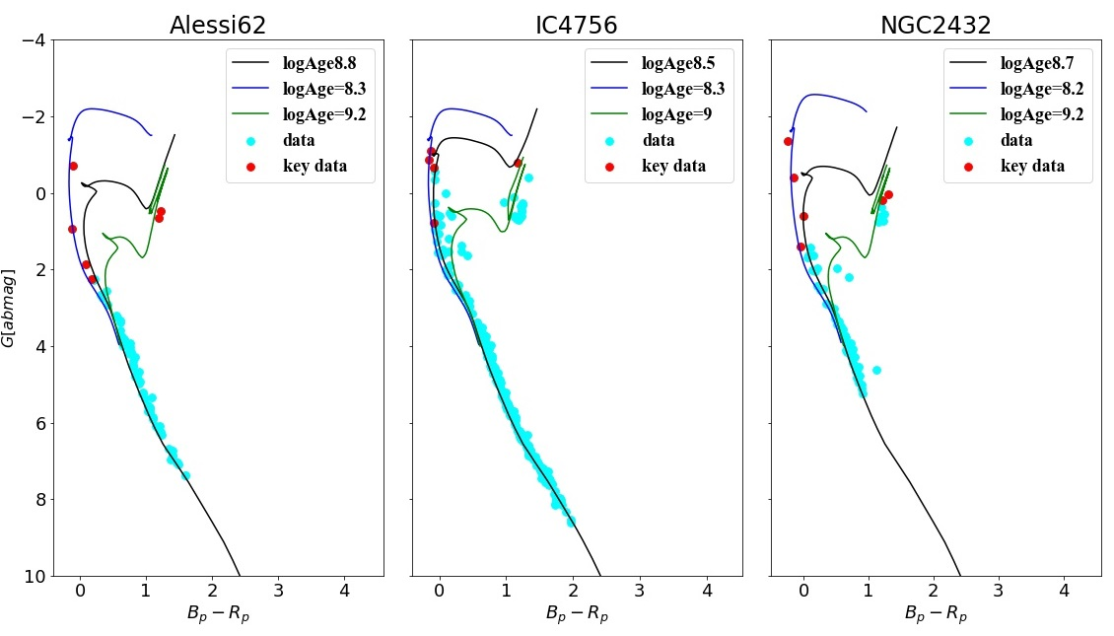
Discussion-Strange OCs

Slide 25
Further work
Fitting model (D. Bossini et al. 2019)
CMD + stellar bolometric corrections model (YBC)
(Yang Chen et al. 2019)

Slide 27
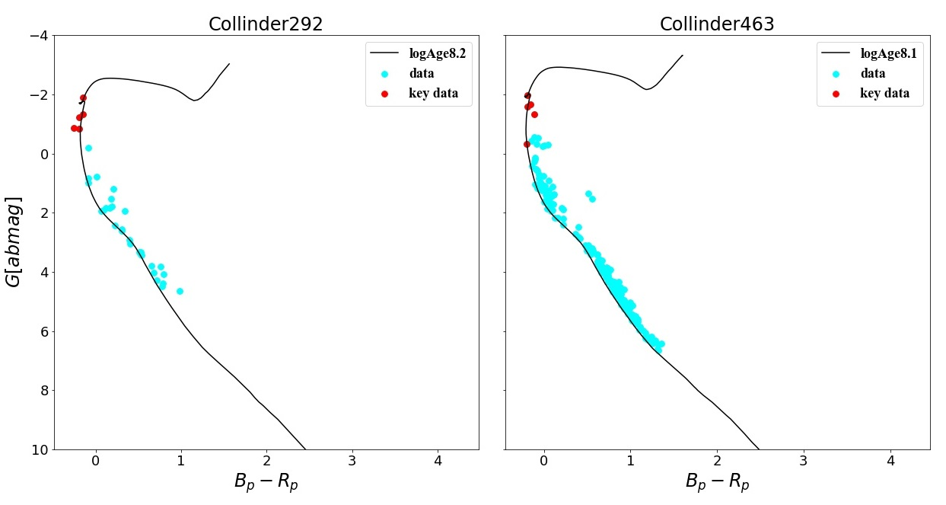
Discussion-Key Data Selection

